Slide 1
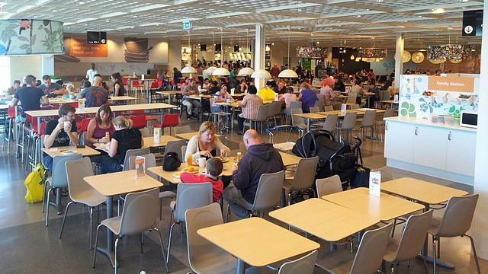
CANTEEN AUTOMATION SYSTEM

Slide 2
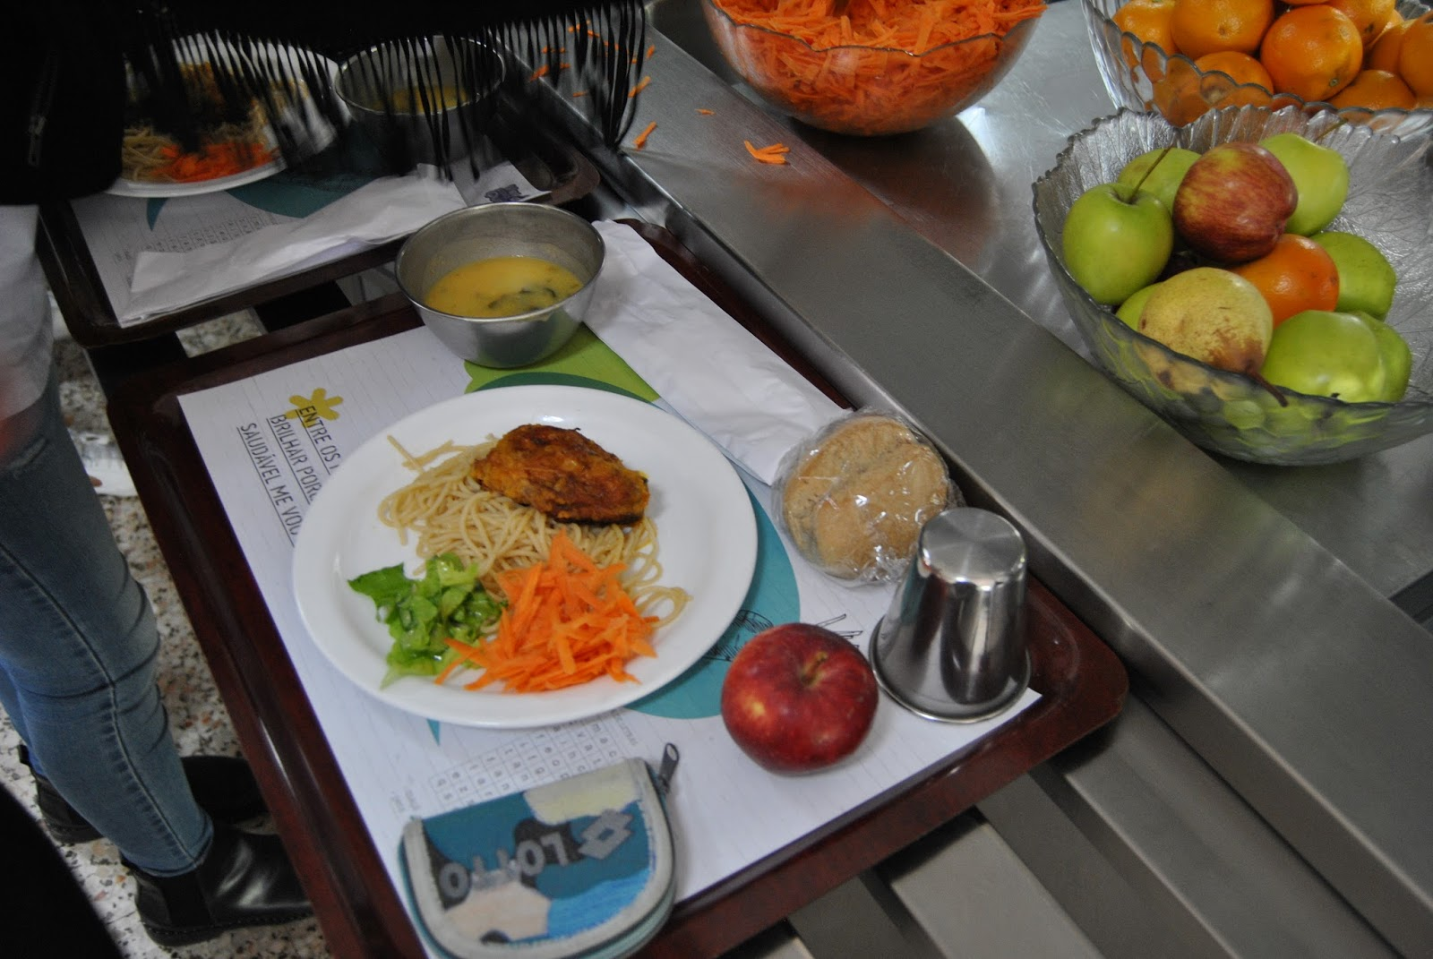
TEAM MEMBERS
Bhargavi M
Alpana T P
P SaiSudha
Nagamani Gade
Janiki Vijayalaxmi
S Spandana
Katyayani Yalla

Slide 3

Road Map
Spring Boot
JPA with Hibernate
Gradle
Junit Testing
Postgres SQL
Tomcat Apache Server
Swagger

Slide 4
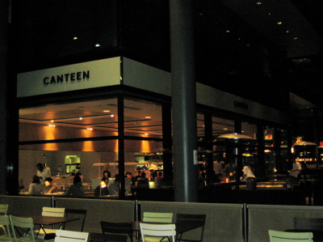
ABSTRACT
This Canteen Automation System enables the end user to register online, read and select the food items from menu card and order food online by just selecting the food that the customer want to have using this application.

Slide 5

INTRODUCTION
The main advantage of this system is that it greatly simplifies the ordering process for both the customer and the canteen.
This also provides instant visual confirmation of what the customer has selected.
This system also greatly lightens the load on the canteen’s end, as the entire process of taking orders is automated.

Slide 6
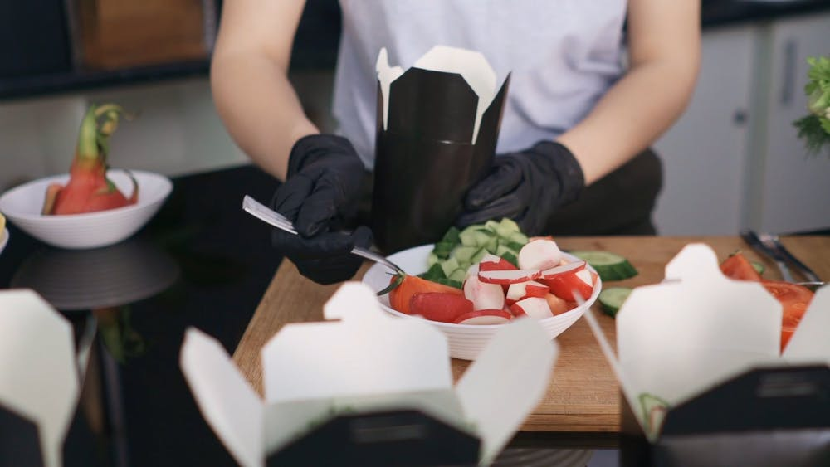
PROBLEM STATEMENT
The most common problem of the manual system of canteen is that the efficiency of the management along with customer satisfaction could not be fulfilled sometimes

Slide 7
OBJECTIVES
To order food rapidly.
To make it convenient for people who have limited time.
Reduced paperwork.
Computerized order and billing system.

Slide 8
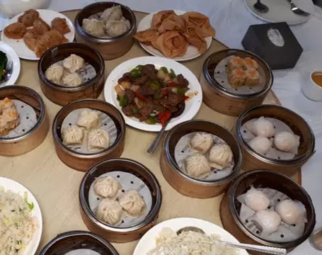
MODULES
Admin.
Staff.
Customer.
Login.
Food Items.
Order.
Cart.
Payment.

Slide 9
Service Interface:
IAdminService
Admin addAdmin(Admin admin)
Admin deleteAdmin(int adminId) throws AdminNotFoundException;
Admin getAdminById(int adminId) throws AdminNotFoundException;
Admin updateAdmin(Admin admin, int adminId)
ILoginService
Login login(Login credentials) throws InvalidCredentialsException;
Login addLogin(Login login);
Optional<Login> deleteLogin(String email);
Optional<Login> getLogin(String email);
ICanteenService
CanteenFood add(CanteenFood id);
List<CanteenFood> getAllCanteenFood();
CanteenFood getCanteenById(int foodId) throws CanteenFoodNotFoundException ;
CanteenFood deleteCanteenFood(int foodId) throws CanteenFoodNotFoundException ;
CanteenFood updateFoodQuantity(int foodId, int foodQuantity) throws CanteenFoodNotFoundException ;
CanteenFood saveCanteenFood(CanteenFood foodId);
IStaffService
Staff addStaff(Staff staff);
Staff deleteStaff(int staffId) throws StaffNotFoundException;
Staff getStaffById(int staffId)throws StaffNotFoundException;
Staff updateStaff(int staffId, String staffname)throws StaffNotFoundException;
IPaymentService
List<Payment> getAllPayments();
List<Payment> getAllPayments();
Payment addPayment(Payment payment);
Payment addPayment(Payment payment);
ICartService
List<Cart> getAllCartItems();
Cart updateItemById(Cart cart, int cartId);
Cart deleteItem(int cartId) throws CartNotFoundException;
Cart updateCartPrice(int cartId, int cartTotal) throws CartNotFoundException;
Cart addItemToCart(Cart foodItem) throws CartNotFoundException;
Cart getCartById(int cartId) throws CartNotFoundException;
IOrderService
Order createOrder(Order order);
List<Order> listAllOrders();
Order selectOrderById(int id);
Order deleteOrderById(int id);
Order updateOrderById(int id, Order order);
ICustomerService
List<Customer> getAllCustomers();
Customer getCusById(int cusId) throws CustomerNotFoundException;
Customer addCustomer(Customer cus);
Customer deleteCustomer(int cusId) throws CustomerNotFoundException;
Customer updateCusAddr(int cusId, Address newAddr) throws CustomerNotFoundException;
Customer updateCustomerById(int cusId, Customer cus) throws CustomerNotFoundException;

Slide 10
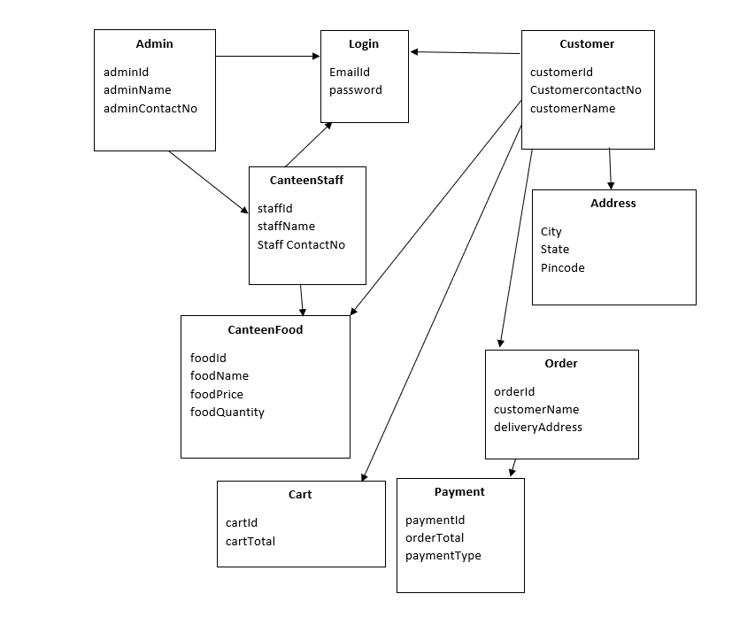
POJO Classes:

Slide 11
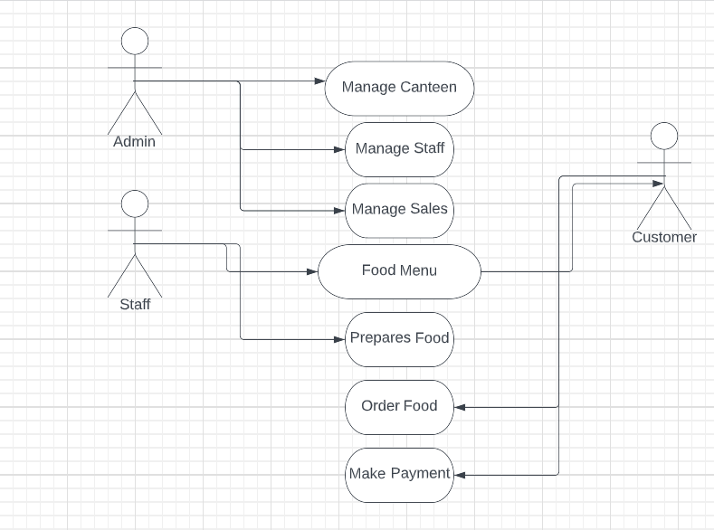
Use Case Diagram

Slide 12
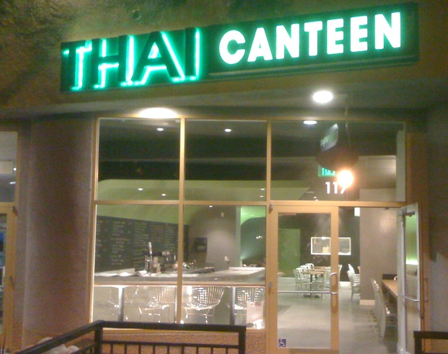
CONCLUSION
This application is efficient in maintaining customer’s details and can easily perform operations on customer’s records and works to handle the information of the food items available in a canteen. This software also reduces the workload of the canteens.

Slide 13
THANK YOU..

